Slide 1
Introduction and Background
CSCI 2050U - Computer Architecture
Randy J. Fortier
@randy_fortier

Slide 2
Course Overview
Introduction, the basics, and background
Information, encoding, and errors
Physics, transistors, and gates
Boolean algebra and combinational circuits
Sequential circuits
Putting it all together (in a CPU)
Assembly language
Memory (time permitting)
Parallel computing
Alternative computing models (e.g. quantum computers)

Slide 3
Lecture Outline
Background
How did we get here?
Basic physics and electronics
Basic circuit diagrams

Slide 4
Background
CSCI 2050U - Computer Architecture

Slide 5
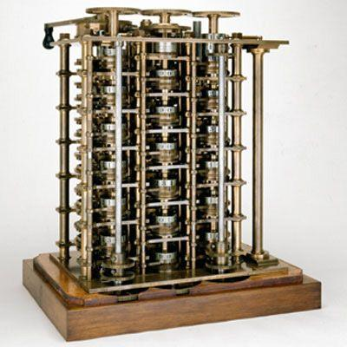
Mechanical Computers
Charles Babbage (1791-1871)
Difference engine (~1822)
Calculating astronomical tables
Analytical engine (never completed)
Programmable

Slide 6
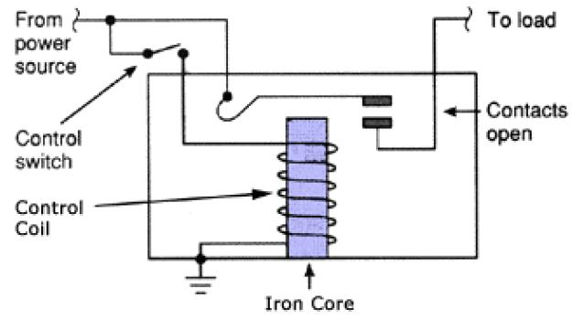
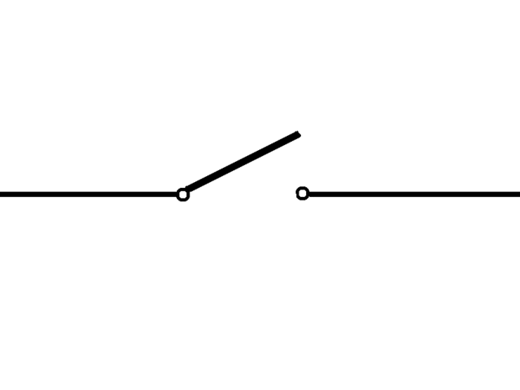
Electromechanical Computers
A relay is an electromechanical device which acts like a switch
Conceived by telegraph operators to relay (forward) a signal
The incoming data creates a new signal with the same output

Slide 7
Electromechanical Computers
Imagine two relays, configured as in these diagrams:
vcc
vcc
x
x OR y
x AND y
x
y
y

Slide 8
Electromechanical Computers
In theory, we could build a computer out of relays
It would be huge
It would use a lot of power
It would be expensive
It would break down a lot
Computers like these were created by Harvard, Bell
1940s - 1950s
Alan Turing used a computer like this to crack the Enigma code in WWII

Slide 9
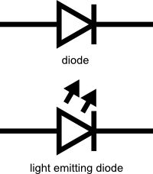
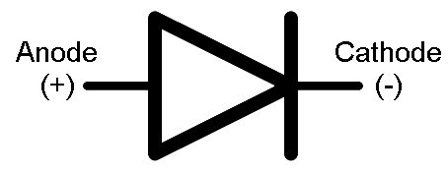
Electronics
Some basic electronics terminology:
Diode: A device that forces flow in a one-dimensional manner
Light Emitting Diode: A diode that produces light
Anode: Electrons flow out (+)
Cathode: Electrons flow in (-)
LED: Light emitting diode

Slide 10
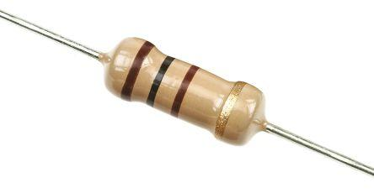
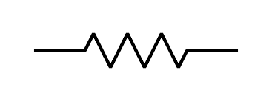
Electronics
Some basic electronics terminology:
Resistance: The degree to which a material resists electron flow
Analogy: A narrow pipe
Measured in Ohms (Ω)
Conductor: A material with low resistance (e.g. gold, copper)
Insulator: A material with high resistance (e.g. glass, rubber)
Semiconductor: A material whose resistance can be modified (called doping)
e.g. silicon, germanium

Slide 11
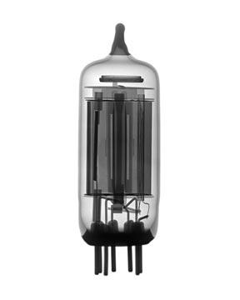
Electrical Computers
Alternatives to relays:
Vacuum tubes
Low pressure tubes with anode and a heated cathode
Photoelectric effect causes electrons to flow only in one direction
ENIAC, Colossus
Expensive, energy waste, often fail
Transistors

Slide 12
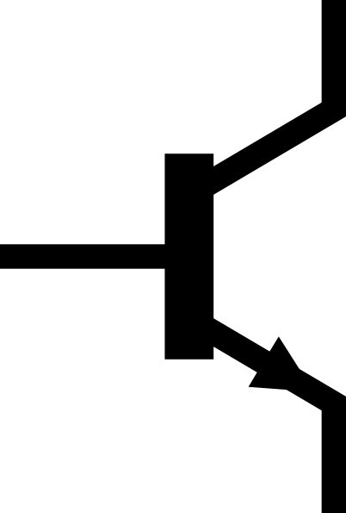
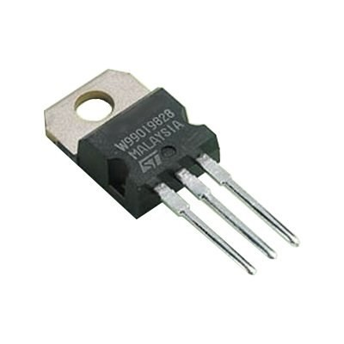
Electrical Computers
Alternatives to relays:
Vacuum tubes
Transistors
Devices made in silicon
Developed in the 1950s and 1960s
Popularized in the 1970s
Energy efficient, small, rarely break down
Primary component of very large scale integration (VLSI) circuits

Slide 13
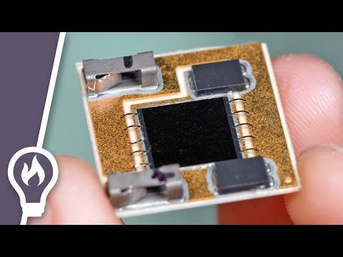
Electrical Computers
Diodes:

Slide 14
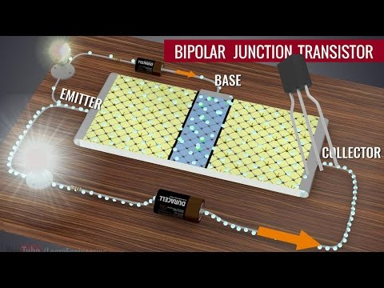
Electrical Computers
NPN Transistors:

Slide 15
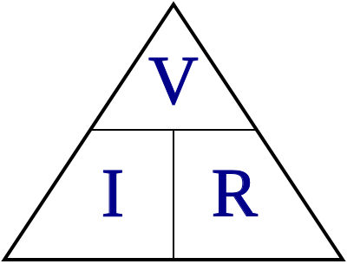
More Electronics
Voltage
A measure of pressure
Unit: volts
Can be negative or positive (direction of pressure)
Handy for encoding (discussed later)
Current
A measure of flow
Unit: Amperes
Wattage
A measure of work
Unit: watts
Ohm’s Law:
V = IR
I = V/R
R = V/I

Slide 16
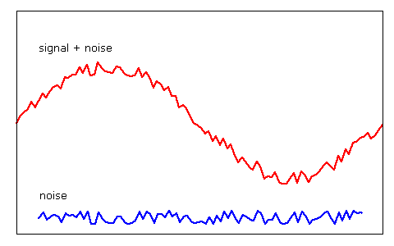
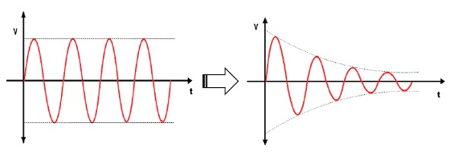
Noise and Attenuation
Noise
Part of a signal that is not intended
e.g. from outside sources
Attenuation
Loss of signal
Reduces the intensity/amplitude of a signal
e.g. Absorption of electrons into the insulator

Slide 17
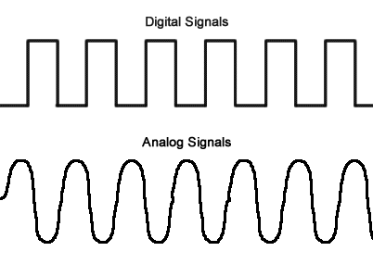
Analog vs. Digital
Digital
Represent only discrete values
e.g. 0-10% of the population voted → +0.5v
Analog
Represent any continuous value
e.g. 71.3% of the population voted → +0.713v
Notes:
It sort of seems like analog is better. After all, we can represent any quantity. The problem is our limitation to produce so precise a voltage, measure it, and also noise.

Slide 18

Decimal vs. Binary
Decimal
Base 10 numbering system (uses digits 0-9 only)
Some decimal computers did exist in the early days (e.g. ENIAC)
Binary
Base 2 numbering system (uses digits 0 and 1 only)
Fewer discrete values means higher likelihood of correctly interpreting an incoming signal

Slide 19
Basic Circuit Components
CSCI 2050U - Computer Architecture

Slide 20
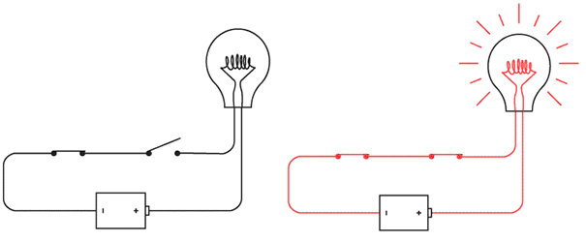
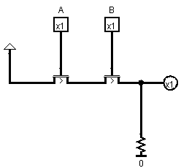
Basic Circuit Diagrams
To wire up a diagram like this:
We can draw a circuit diagram like this:

Slide 21
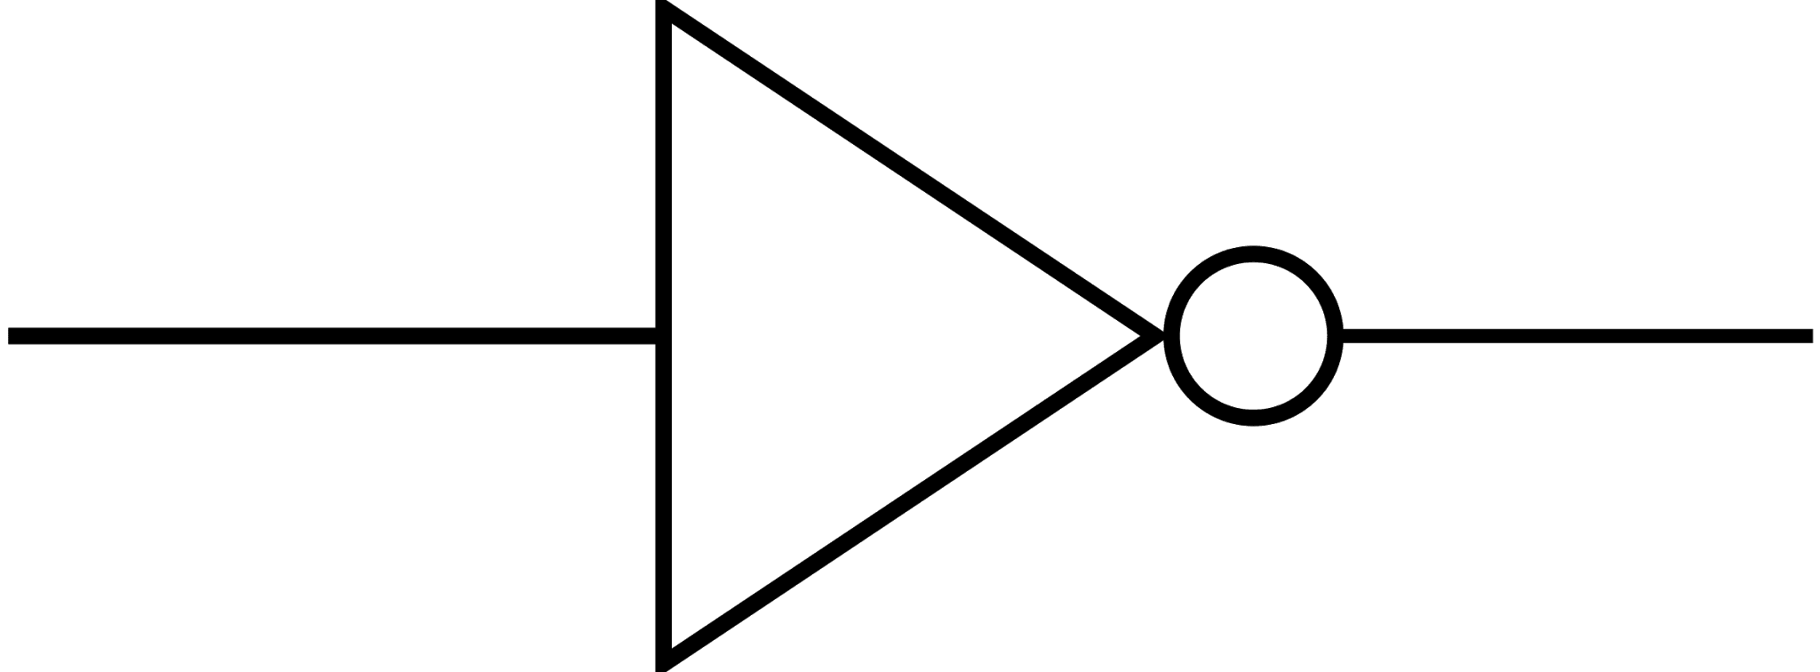
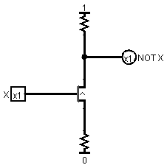
Basic Circuit Diagrams
Inverter:
A | NOT A (A’)
0 | 1
1 | 0

Slide 22
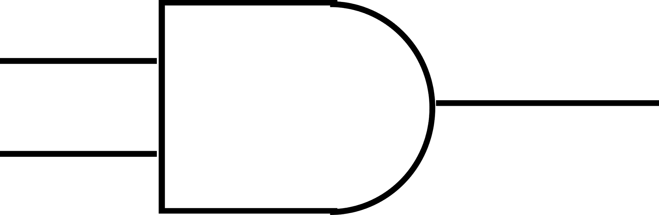
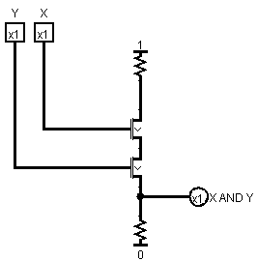
Basic Circuit Diagrams
AND:
A | B | A AND B (AB)
0 | 0 | 0
0 | 1 | 0
1 | 0 | 0
1 | 1 | 1

Slide 23
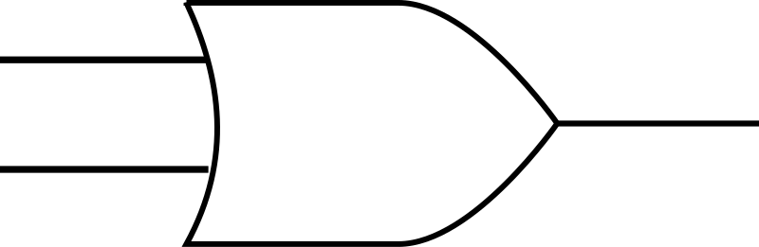
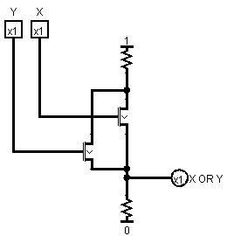
Basic Circuit Diagrams
OR:
A | B | A OR B (A+B)
0 | 0 | 0
0 | 1 | 1
1 | 0 | 1
1 | 1 | 1

Slide 24
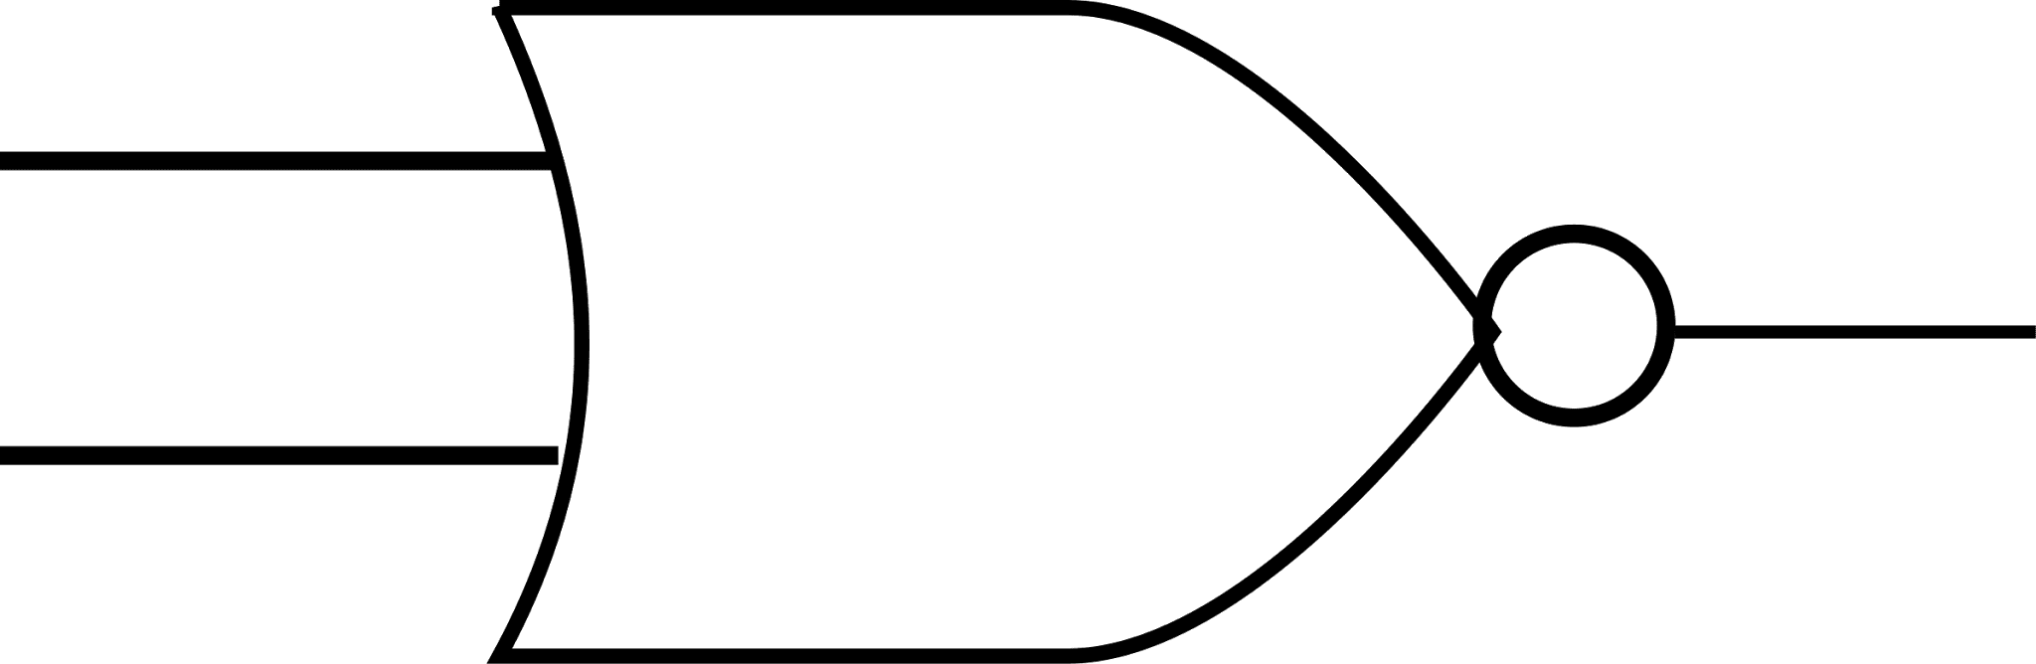

Basic Circuit Diagrams
NOR:
A | B | A NOR B
0 | 0 | 1
0 | 1 | 0
1 | 0 | 0
1 | 1 | 0

Slide 25
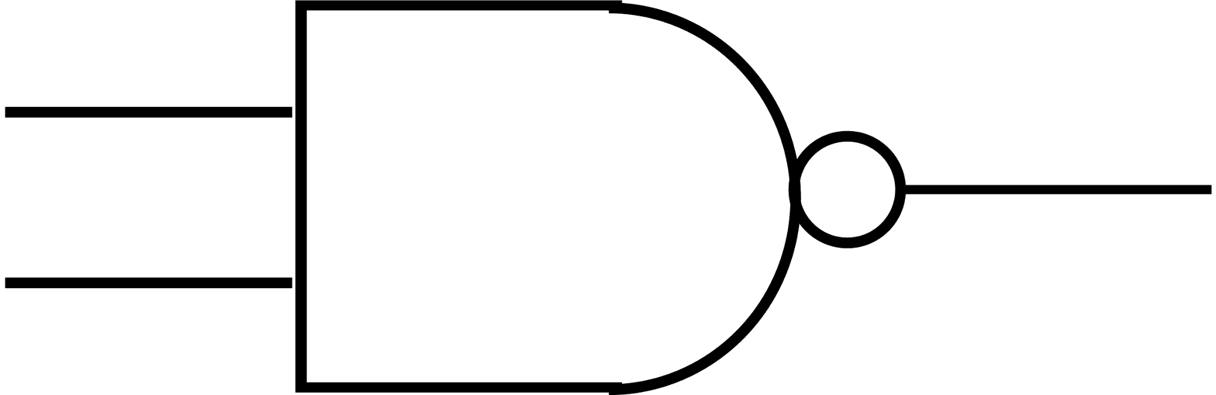
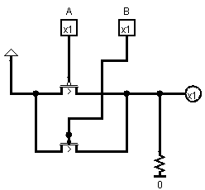
Basic Circuit Diagrams
NAND:
A | B | A NAND B
0 | 0 | 1
0 | 1 | 1
1 | 0 | 1
1 | 1 | 0

Slide 26
Terminology
CSCI 2050U - Computer Architecture

Slide 27
Terminology
Prefixes:
Nano - 1/1,000,000,000th
Nanosecond - one clock cycle
Nanometre - transistor size
Micro (μ) - 1/1,000,000th
Microsecond - execution time of an instruction
Milli - 1/1,000th
Millisecond - execution time of a while loop

Slide 28
Terminology
Prefixes:
Kilo - 1,000
Kilobyte - Internet packet size
Mega - 1,000,000
Megabyte - cache size
Giga - 1,000,000,000
Gigabyte - RAM size
Gigahertz - CPU/GPU clock speed
Tera - 1,000,000,000,000
Terabyte - Hard disk/SSD size

Slide 29
Homework
Install one of the following two digital circuit design packages before our next lecture:
LogiSim - http://www.cburch.com/logisim/
LogiSim Evolution - https://github.com/reds-heig/logisim-evolution

Slide 30
Wrap-up
Course overview
Background
mechanical → electromechanical → electrical
relays → vacuum tubes → transistors
basic electronics
digital vs. analog
binary vs. decimal
Basic circuit diagrams
Terminology

